Slide 1
Predicting Breast Cancer Using Machine Learning
Capstone Project
By - Lakshika Jain

Slide 2
Objective
Build a machine learning model to identify whether breast tumor features are benign or malignant.
Dataset sourced from Kaggle with 32 features related to the size, texture, and shape of tumors.

Slide 3
Data Overview
Dataset
32 columns, 600 rows, with features describing tumor size, shape, and texture.
Diagnosis is the target variable, classified as Malignant (M) or Benign (B).
Data Cleaning
Removed ID and unnamed columns.
No null values or features with zero variance.
Class Distribution
357 benign cases.
212 malignant cases.

Slide 4
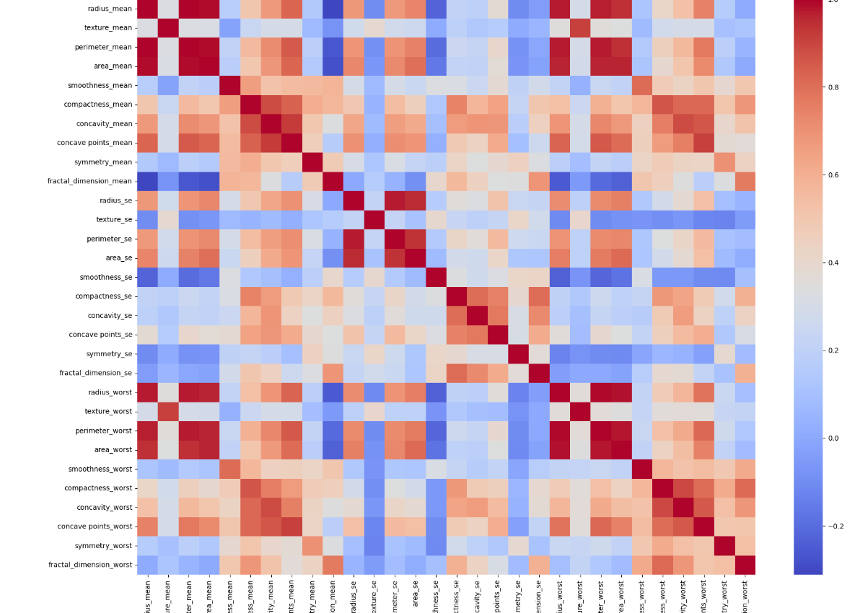
Data Exploration
High Correlation: Significant multicollinearity between features, especially between "mean" and "worst" measurements.

Slide 5
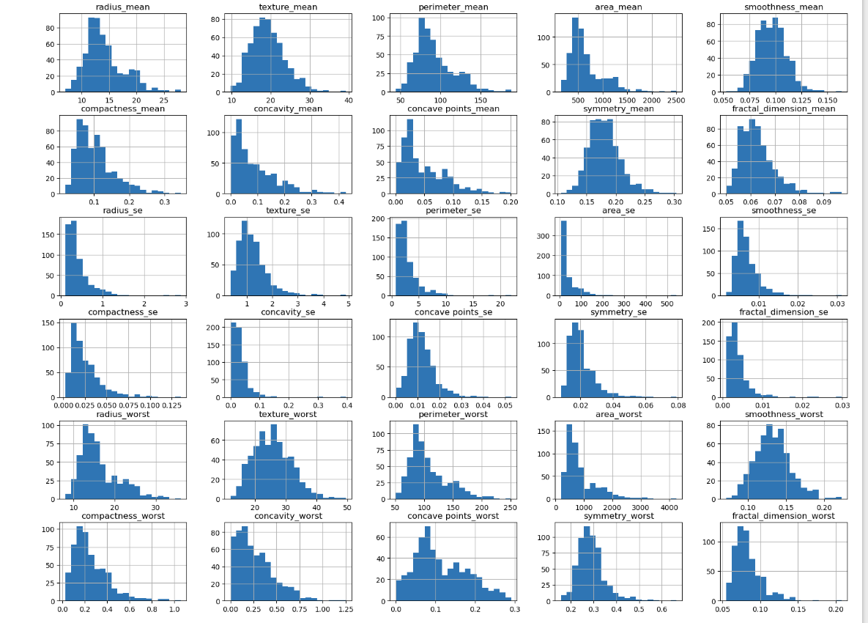
Data Exploration
Skewed Distributions: Many features were right-skewed (e.g., radius_mean, area_mean).
Outliers: Some features had potential outliers (e.g., area_mean, perimeter_mean).

Slide 6
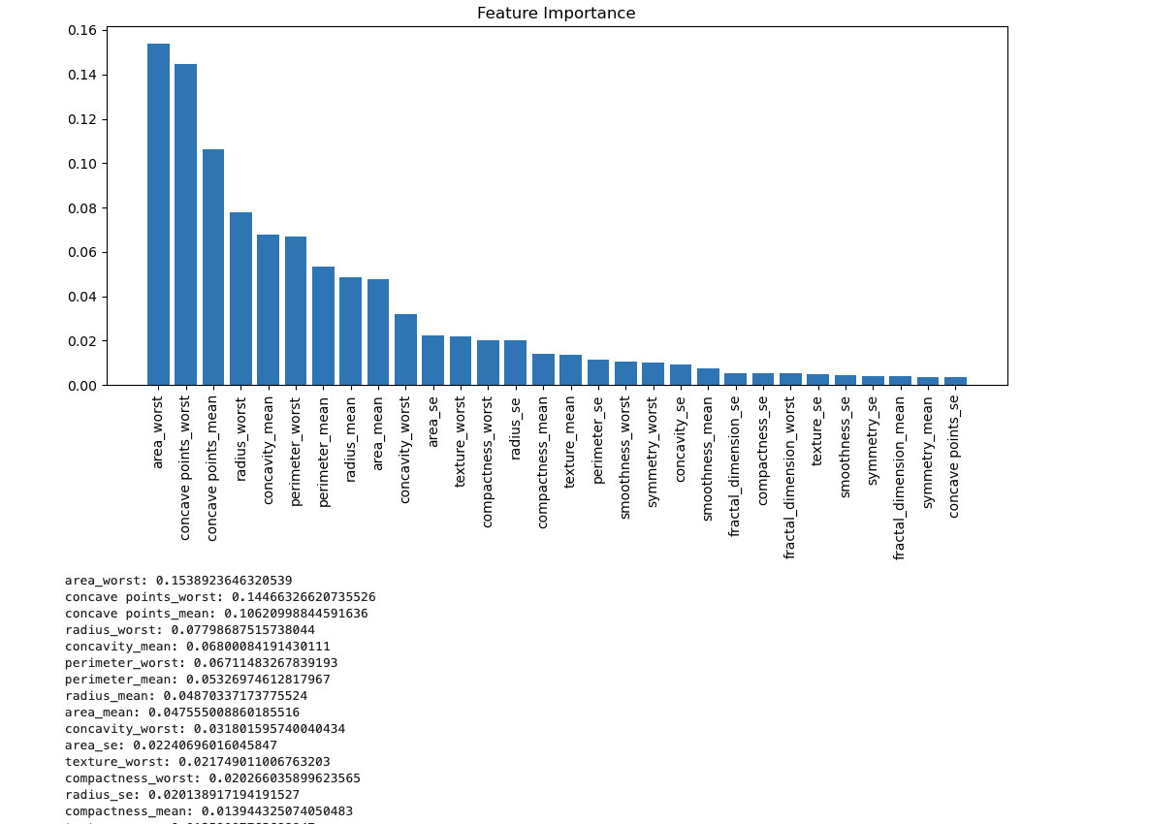
Feature Importance
Top Features
Area_worst, concave points_worst, and concave points_mean were the most influential.
Shape and size-related features played the most significant role in predicting malignancy.
Less Important Features
Fractal dimension and symmetry were less critical in predicting outcomes.
Feature Selection Strategy
Features with low importance were dropped to reduce noise and improve model performance.

Slide 7
Modeling Process
Data Preparation
Normalized features and split the dataset into training and validation sets (70:30 split).
Models Used
Logistic Regression
Support Vector Machine (SVM)
K-Nearest Neighbors (KNN)
Neural Networks
Evaluation Metrics
Accuracy, Precision, Recall, and F1-Score were used to evaluate model performance, with a focus on recall for malignant cases (important for medical diagnosis).

Slide 8
Model Performance Comparison
Logistic Regression
Accuracy: 97.08%, Recall (Malignant): 95%
Balanced performance, interpretable model, strong performance for recall.
SVM
Accuracy: 95%, Precision (Malignant): 98%, Recall (Malignant): 87%
High precision but lower recall for malignant cases, missing some critical detections.
KNN
Accuracy: 92%, Recall (Malignant): 89%
Lower performance compared to other models.
Neural Networks
Accuracy: 97.66%, Balanced precision and recall for both benign and malignant cases.

Slide 9
Neural Network Architecture
Neural Network Details
Input Layer: Number of features in the dataset.
Two Hidden Layers:
First layer: 224 neurons.
Second layer: 512 neurons.
Dropout rate: 0.2 to prevent overfitting.
Output Layer: Single neuron with sigmoid activation for binary classification.
Hyperparameter Tuning
Keras Tuner Used
Tuned hyperparameters:
Number of neurons in hidden layers.
Dropout rate.
Learning rate.
Best Parameters
First Layer: 224 neurons
Second Layer: 512 neurons
Learning Rate: 0.01
Dropout: 0.2

Slide 10
Final Model Performance
Neural Network Results
Validation Accuracy: 94.93% after tuning.
Test Accuracy: 94.74%, showing strong generalization on unseen data.
Cross-Validation:
SVM: 96.48% accuracy (with some instability).
KNN: 91.87% accuracy.
Logistic Regression: 95.82% accuracy.
Neural Network: 87.70% (before tuning).

Slide 11
Key Findings
Best Model: Neural Network, achieving the highest accuracy and balance between precision and recall.
Logistic Regression: A strong alternative, simpler and more interpretable with high recall.
SVM: High precision but lower recall, making it less ideal for medical diagnosis.
KNN: Performed reasonably well but less robust than other models.

Slide 12
Conclusion
Neural Networks performed best overall, especially for malignant case recall, making it ideal for medical diagnosis.
Logistic Regression provides strong performance with greater interpretability.
Further tuning or ensemble methods could improve KNN or SVM performance.

Slide 13
Future Work
Future work can focus on both improving model performance and expanding its applicability. Ensemble methods, deep learning advancements, and feature engineering can lead to better models.

